Slide 1
A.P.Shah Institute Of Technology
Master TimeTable Generator
Project Guide :Dr. Rahul Ambekar
Group Members: Moodle ID:
Suraj Thakkar 16102057
Neel Dhruva 17202003
Adesh Thosani 17202001

Slide 2
CONTENTS
Introduction
Problem Statement
Literature Review
Overview
Proposed Solution
Constraints
Use Case Diagram
Class Diagram
Technology Stack
Algorithms
References

Slide 3
Introduction
Time tables are usually prepared manually.
Manual process of preparing timetables is not only hectic but also prone to several errors.
Time Table Preparation is difficult because of limited & overlapping resources .
So now the time table needs to schedule the faculty at provided time slots in such a way that their timings do not overlap and the time table schedule makes best use of all faculty subject demands
Timetable generator automatically schedules timetable for students and faculty which reduces the manual work.
Once the inputs like faculty with their respective subjects are given it will generate the period slots for the given semester.

Slide 4
Problem Statement
For all educational institutions, the timetables are prepared manually.
The class time-table module mainly focuses on year,semester,branch and section.By selecting the above fields, it will display the appropriate Department time-tables.
The faculty time-tables focuses on faculty and faculty name.
By selecting the above fields it will display the timetable with the faculty, respective loads and the preferred time slots.

Slide 5
Literature Review
Evolutionary techniques have been used to solve the time table scheduling problem [1].
Methodologies like Genetic Algorithms (GAs), Evolutionary Algorithms (EAs) etc have been used with mixed success [2].
In this , we have reviewed the problem of educational time table scheduling and solving it with genetic algorithm [3].

Slide 6
Overview
This project addresses the Timetabling Problem, which covers a very broad range of real problems faced continually in educational institutions, and we describe how Evolutionary Algorithms (EAs) can be employed to Effectively address arbitrary instances of automated timetabling problem.
Automated Timetable Generator application will simplify the process of time table generation smoothly which may otherwise needed to done using spread sheet manually possibly leading to constraints problem that are difficult to determine when time table is generated manually.

Slide 7
Proposed solution
The proposed system is designed to be more efficient than the actual manual system.
Most colleges have a number of different courses and each course has ‘n’ number of subjects. Now there are limited faculties, and each faculty might be teaching more than one subjects.
So now the time table needed to schedule all the faculty at provided time slots in such a way that their timings do not overlap and the time table schedule will make the best use of all faculty subject demands.

Slide 8
Constraints
Constraints are limitations that are outside the control of the project team and need to be manage around. They are not necessarily problems. However the problem manager should be aware of constraints because they represents limitations that the project must execute within.
Hard Constraints: A timetable which breaks hard constraints is not a feasible solution, and must be repaired or rejected by the timetabling algorithm.
Soft Constraints: They are less important than hard constraints and it is usually impossible to avoid breaking at least some of them.

Slide 9
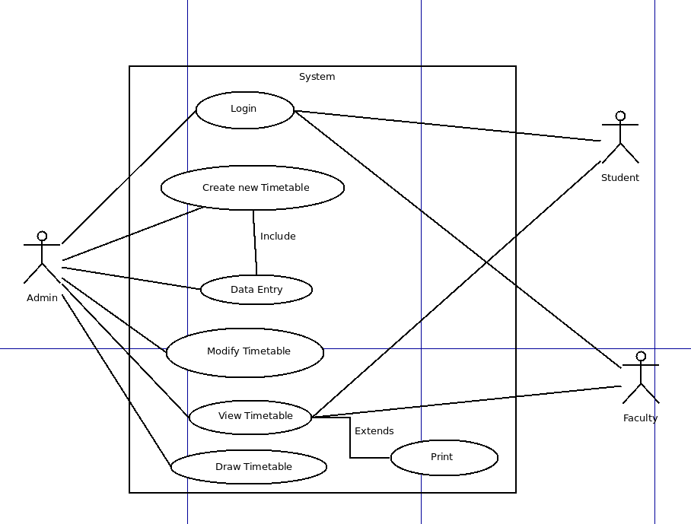
Use Case Diagram

Slide 10
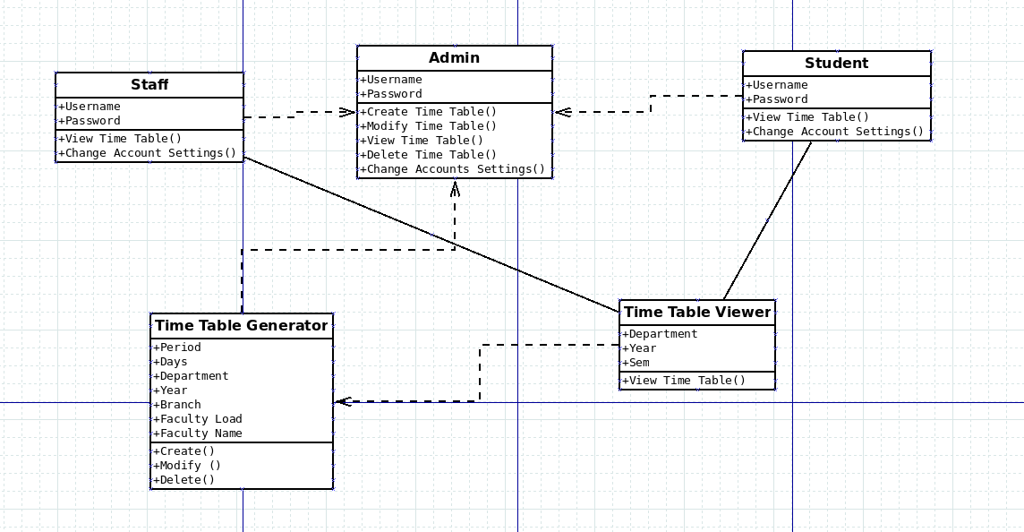
Class Diagram

Slide 11
Technology stack
Various algorithms will be used for implementing this applications.
Genetic Algorithms
Different languages will be used.
C,JAVA,HTML,CSS,PHP.
Different databases will be created for this :
MySQL
MongoDB

Slide 12
Algorithms
Genetic Algorithms:- It is a method for both constraints and unconstraints optimization problem that is based on natural selection, the process that drives biological evolution.
The evolution usually starts from a population.
Selection of chromosome according to fitness
Crossover between selected chromosomes
Perform mutation
Check for condition
Terminlogies of GA
Gene
Chromosome
Population
Reproduction
Crossover
Mutation

Slide 13
References
Meysam Shahvali Kohshori, Mohammad saniee abadeh,Hedieh Sajedi “A fuzzy genetic algorithm with local search for university course timetabling” 2008 20th IEEE International conference [1].
Abramson D., Abeh, A Parallel genelic algorithm for Solving the school Timetabling Problem., Royal Melbourne Institute of technology, 1991 [2] .
MlLENA KAROVA Drparliiieiit of Cantpuler Scierice Studenrska I Trcliniral Uiiiversily Vama [3] .

Slide 14
Thank you!!!

